Slide 1
Expt. 8: L-Proline catalyzed Asymmetric Aldol Reaction of Acetone with p-tolylbenzaldehyde

Slide 2
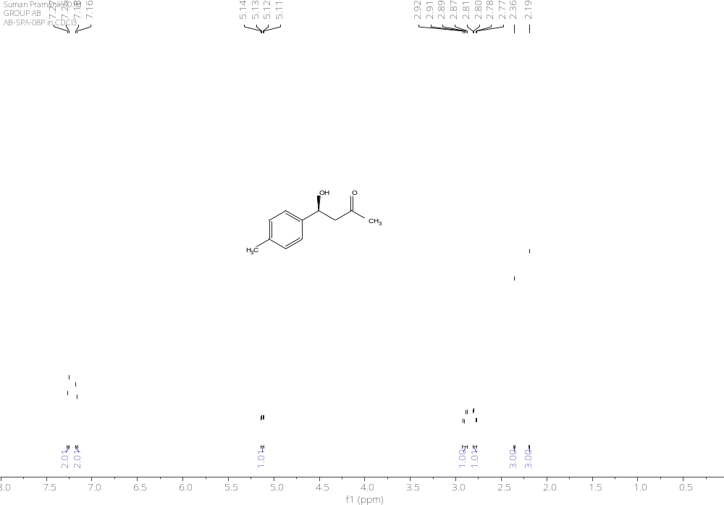
¹H NMR (400 MHz, CDCl₃)

Slide 3
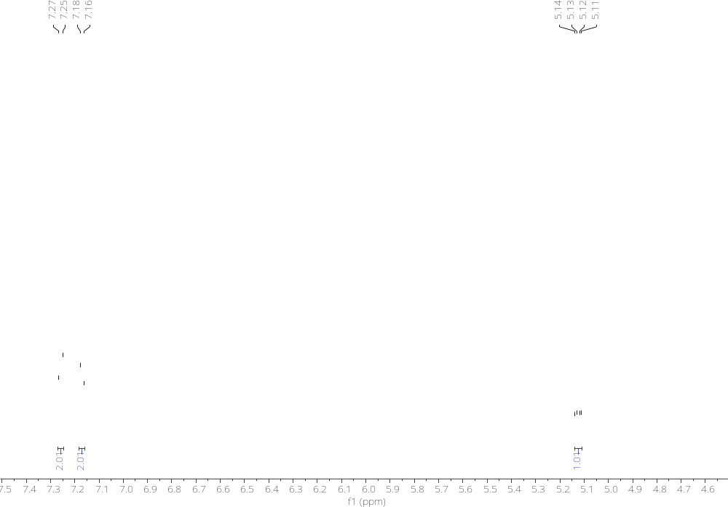
¹H NMR (400 MHz, CDCl₃)

Slide 4
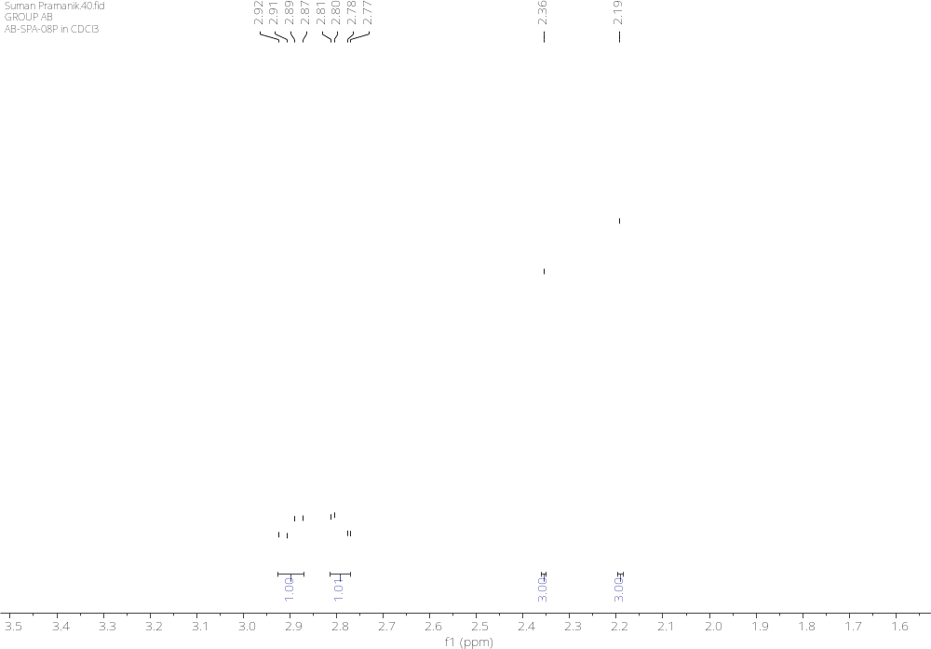
¹H NMR (400 MHz, CDCl₃)

Slide 5
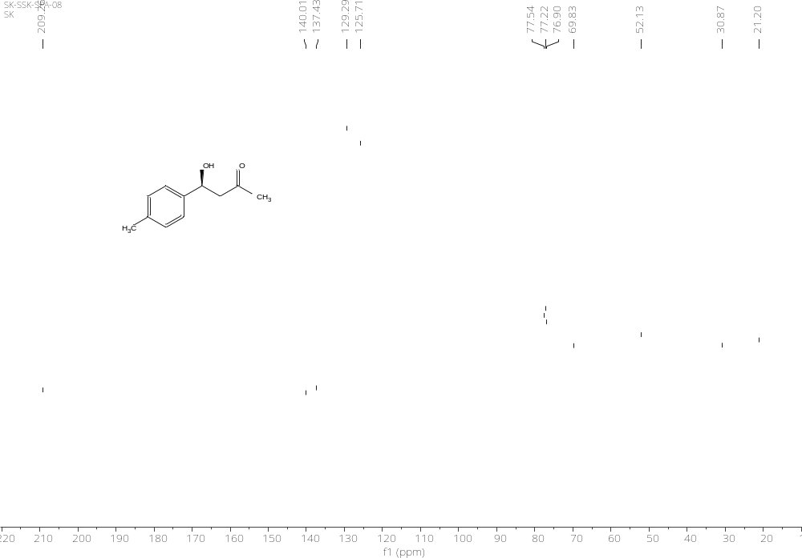
¹³C NMR (101 MHz, CDCl₃)

Slide 6
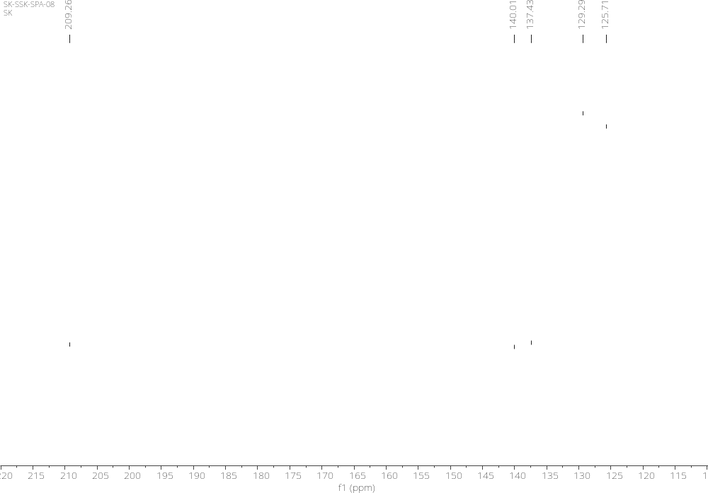
¹³C NMR (101 MHz, CDCl₃)

Slide 7
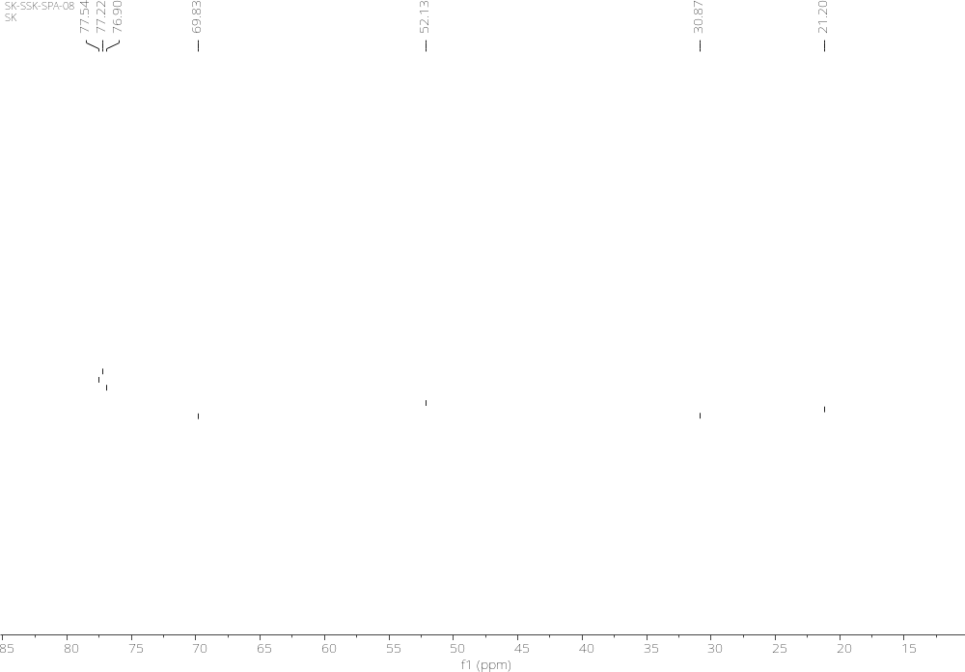
¹³C NMR (101 MHz, CDCl₃)

Slide 8
Exp 9: Multicomponent reaction: Ugi reaction

Slide 9
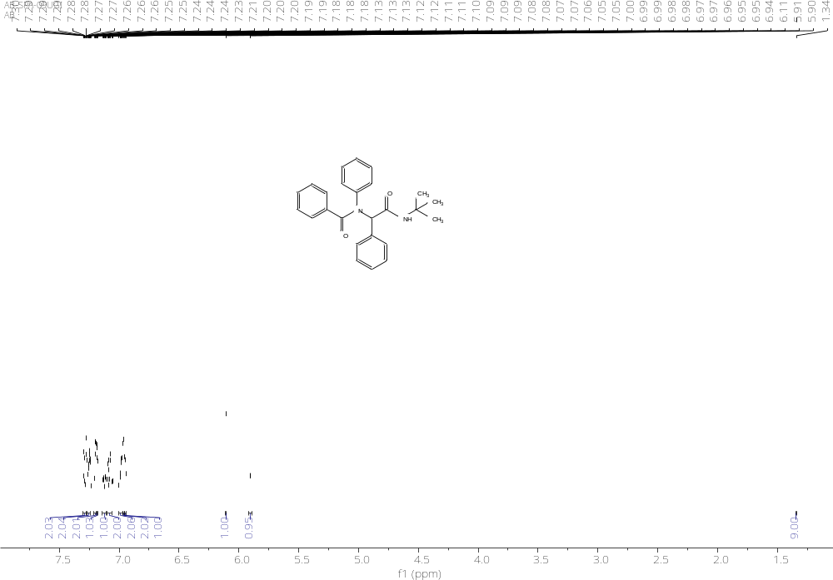
¹H NMR (400 MHz, CDCl₃)

Slide 10
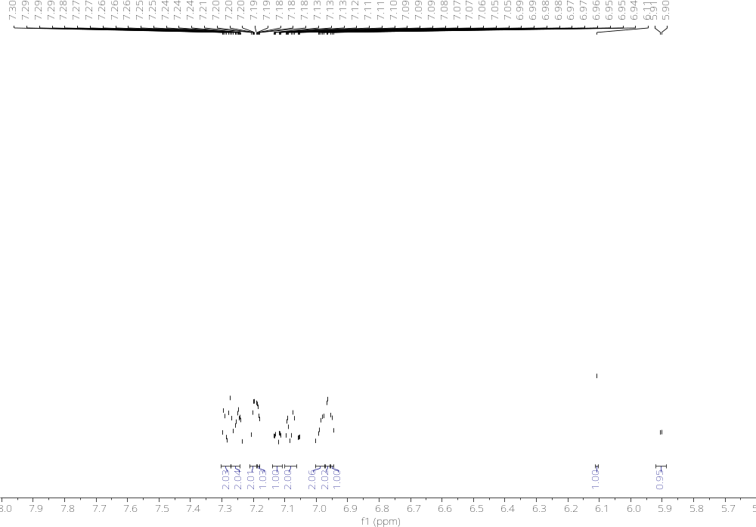
¹H NMR (400 MHz, CDCl₃)

Slide 11
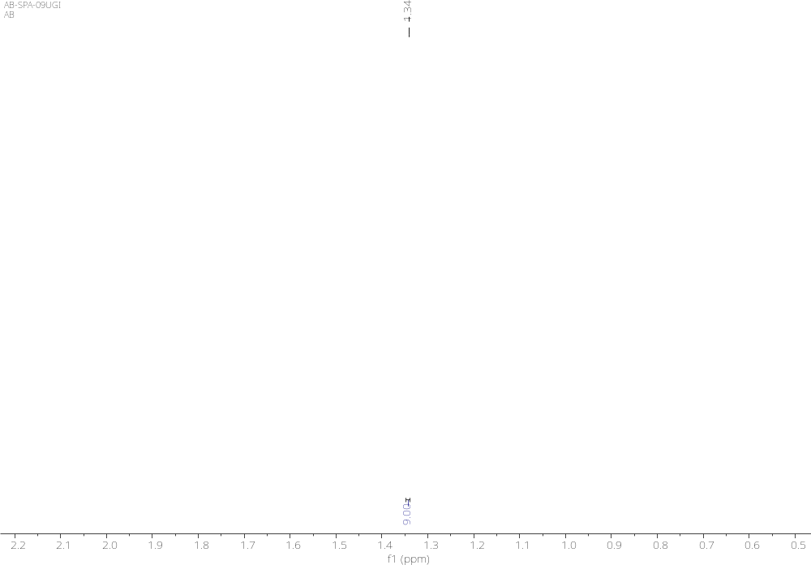
¹H NMR (400 MHz, CDCl₃)

Slide 12
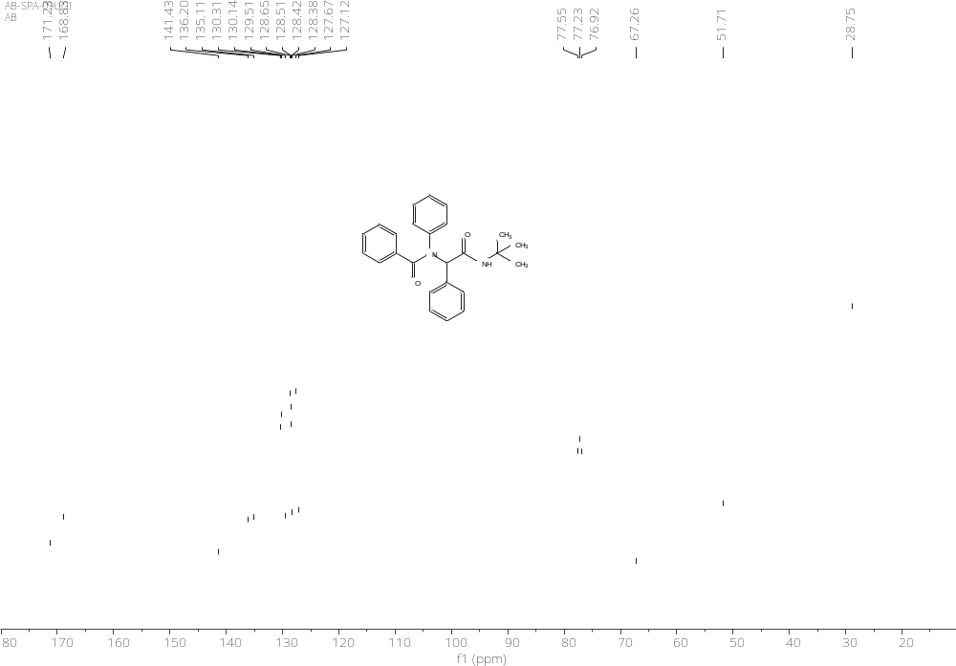
¹³C NMR (101 MHz, CDCl₃)

Slide 13
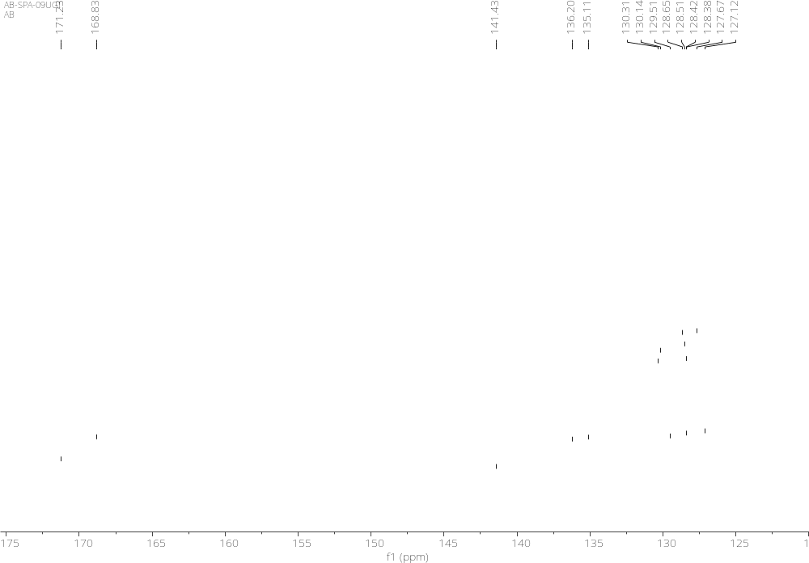
¹³C NMR (101 MHz, CDCl₃)

Slide 14
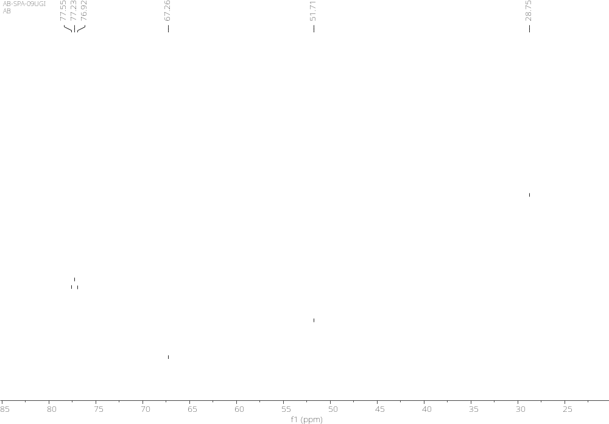
¹³C NMR (101 MHz, CDCl₃)

